Slide 1

Welcome
Lab 8- Managing & Growing your Online Business

Slide 2
Expectations
Chat Support Available During Webinars
Knowing Your Resources
Webinar Process
Facebook Support
Search: Crexendo UP Website Competition
Online Resources
up.Crexendo.com/unr

Slide 3
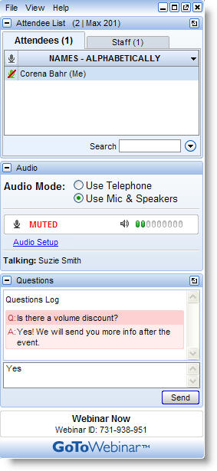
Live presentation
Attendees are muted
Type your questions in the “Questions” window
Questions answered live or via chat reply

Slide 4


Prepare
Brainstorm
Select
Refine
Research
Browser compatibility – Google Chrome
Use of add-on’s
Business License

Slide 5
Introduction
Prepare
Brainstorm
Select
Refine
Research
Create a list of possible products
Select 1 of your Product Ideas
Take 5 min to think of keyword alternatives for that product
Type in 1 of your keyword ideas in the Google Keyword Tool
Export file
Business License

Slide 6
Introduction
Prepare
Brainstorm
Select
Refine
Research
From your exported file, remove any keyword phrases that are not relevant and/or have a low GMS
Add all of the page ranks within the first page of Google and use the Page Rank Calculator to get the average
  Do NOT include Google Images, Google Shopping, or Google Places results when adding page ranks
Repeat the previous steps with a new keyword idea until you have enough data to review
Copy & Paste the final list of keyword phrases into the Keyword Research Document
Business License

Slide 7
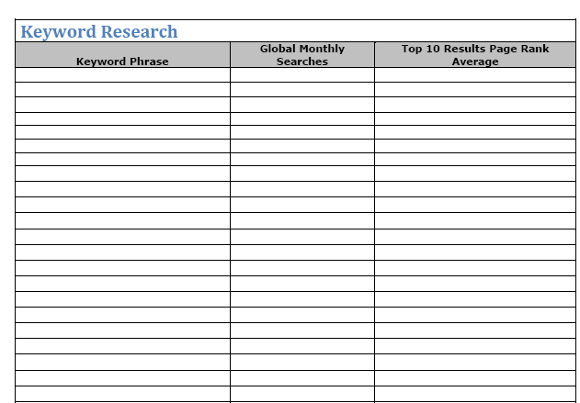
Introduction
Using Google Chrome search for product
Search 1 Keyword phrase at a time
Repeat process until you have the average page rank for all Keyword phrases
Prepare
Brainstorm
Select
Refine
Research
Business License

Slide 8
Introduction
Prepare
Brainstorm
Select
Refine
Research
Using the competition legend, color code your results
Repeat the same process for additional product ideas on a separate Keyword Research template and compare the product markets
Final Step: Select a Product
Business License

Slide 9
Introduction
Prepare
Brainstorm
Select
Refine
Research
Contact your individual state and obtain regulations and requirements
Follow the link on the resources site for further assistance
Business License

Slide 10
Lab 2
Review
Finding a Dropshipper
Contacting Dropshippers
Processors
Shipping
Pros and Cons of a Dropshipper
  Inventory
  Shipping
  Returns
Finding a dropshipper
  Google
  www.dailytrader.com
Q&A

Slide 11
Lab 2
Review
Finding a Dropshipper
Contacting Dropshippers
Processors
Shipping
Email Template available
Dropshipper Comparison Tool
Following up
Expectations
Selection
Q&A
Notes:
Show email template for contacting dropshippers
Discuss the Dropshipper comparison sheet.

Slide 12
Lab 2
Review
Finding a Dropshipper
Contacting Dropshippers
Processors
Shipping
What are Payment Processors?
PayPal vs. Merchant Accounts
Linking to Builder
  Processors
  Price Sets Payment Methods
Q&A

Slide 13
Lab 2
Review
Finding a Dropshipper
Contacting Dropshippers
Processors
Shipping
UPS Integration
Other options
Introduction to Ordering Rules
Q&A

Slide 14
Lab 3
Webinar 2 Review
Builder Navigation
CRO Headers
Page Building
Elements
Understanding the Builder
  Tabs
  Designs(Layouts)
    Selection
    Columns
  Schemes
    Customizing
Q&A

Slide 15

Lab 3 CRO Header
Webinar 2 Review
Builder Navigation
CRO Headers
Page Building
Elements
Q&A

Slide 16
Lab 3
  Pages
    Home Page
    Products Page
    About Us Page
    Contact Us Page
    Privacy Policy Page
Webinar 2 Review
Builder Navigation
CRO Headers
Page Building
Elements
Q&A

Slide 17
Lab 3
Webinar 2 Review
Builder Navigation
CRO Headers
Page Building
Elements
  Introduction to Elements
  Layers
  Types of Elements
  Adding Elements from Preview
Q&A

Slide 18
Lab 3
  Most used elements
    Text Element
    Image Element
    Category Products
    Page List
    Product
Webinar 2 Review
Builder Navigation
CRO Headers
Page Building
Elements
Q&A

Slide 19
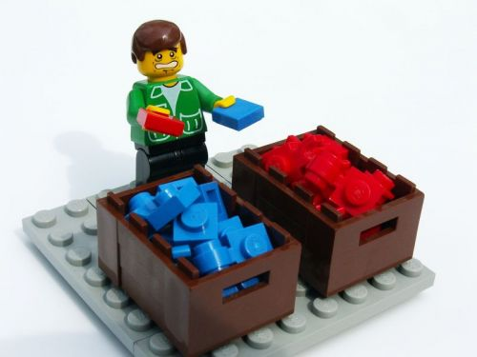
Lab 4
Webinar 3 Review
SEO Keyword Map
Categorizing Keywords
Copy
Domains
  SEO Keyword Map
    Take Green Competition
    Insert in SEO Keyword Map
Q&A
  Categorize them into groups of similar keywords
Notes:
Click over to keyword map and show how to complete the Categorization.

Slide 20
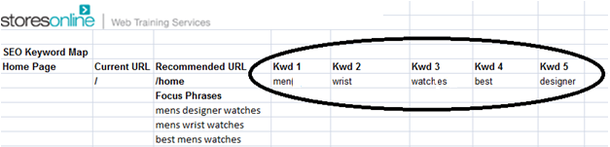
Lab 4
Webinar 3 Review
SEO Keyword Map
Categorizing Keywords
Copy
Domains
  Take one group and place under “focus phrases” on SEO Keyword Map
  Separate the individual words from the focus phrases to get the Keywords to focus on for each page.
Q&A

Slide 21

Lab 4
Webinar 3 Review
SEO Keyword Map
Categorizing Keywords
Copy
Domains
Search Engines
Site Visitors
What do search engines want?
Keyword Density
300-500 words
Be about something
2-4%
Q&A

Slide 22

Lab 4
Webinar 3 Review
SEO Keyword Map
Categorizing Keywords
Copy
Domains
What do Visitors Want?
What the words say
  Write clear and to the point.
  Answer their question
  An active voice.
  Appeal to emotion
  Include a call to action
WHY BUY HERE?
Q&A

Slide 23
Lab 4
Webinar 3 Review
SEO Keyword Map
Categorizing Keywords
Copy
Domains
What do Visitors Want?
How the words are formed.
  Skimmability
  Add $%*@ to the text
Q&A

Slide 24
Lab 4
Webinar 3 Review
SEO Keyword Map
Categorizing Keywords
Copy
Domains
What makes up a great domain name?
  Place keywords in domain name
Registering a Domain
Purchasing a Domain
www.domainname.com
Q&A

Slide 25
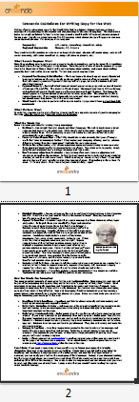
Lab 5
Webinar 4 Review
Writing Copy
Categories
Taxes & Ordering Rules
Publishing
Products
Make your text “Skimmable”.
Q&A

Slide 26
Lab 5
Webinar 4 Review
Writing Copy
Categories
Taxes & Ordering Rules
Publishing
Products
Where are the goods?
Adding a product
Uploading list by Spreadsheet
Price$
What are SKU doing?
Q&A

Slide 27
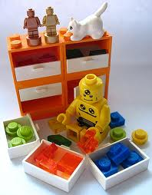
Lab 5
Webinar 4 Review
Writing Copy
Categories
Taxes & Ordering Rules
Publishing
Products
Categories
Why/What/Whom/Where
Sorting Products
Creating Categories and sub categories.
Q&A

Slide 28


Lab 5
Webinar 4 Review
Writing Copy
Categories
Taxes & Ordering Rules
Publishing
Products
Uncle Sam- Getting Taxes Linked
Adding Coupons into your site
Q&A

Slide 29
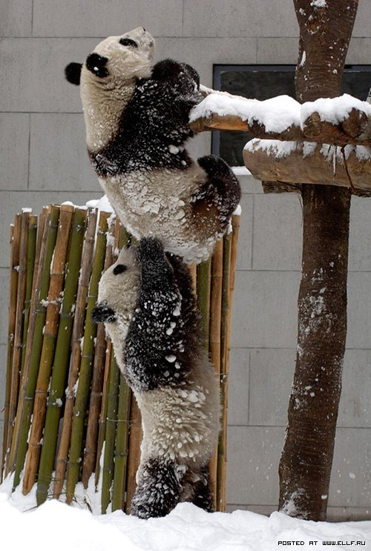
Lab 5
Webinar 4 Review
Writing Copy
Categories
Taxes & Ordering Rules
Publishing
Products
  Back Up
  Publish
  Restoring
Almost There
Q&A

Slide 30

Lab 6
Webinar 5 Review
Live Directories
Free Live Directories
Paid Live Directories
Social Bookmarking
Q&A
Notes:
Web directories are large, topical, searchable directories that differ from traditional relevancy search engines in that their content is maintained by actual humans rather than by 'robot spyders' checking your site. Hence they are "live." Web directory personnel review your site and decide whether to include your website in their index. Sites in the index are located by browsing, by category, or by searching sites in the index using simple keyword matching. There are over a hundred Web directories on the Internet, each of varying importance. Nevertheless, your strategy should be to submit to all of them, if possible.

Slide 31
Lab 6
Webinar 5 Review
Live Directories
Free Live Directories
Paid Live Directories
Social Bookmarking
Free Live Directories List
DMOZ | Free | 8
MiriBlack | Free | 6
MasterMOZ Directory | Free&Paid | 6
Londovor | Free&Paid | 6
My Green Corner | Free&Paid | 6
The Shoppings | Free&Paid | 6
SEO Court | Free&Paid | 6
Can Links | Free | 5
Search Sight | Free | 5
Free Website Directory | Free&Paid | 5
eSearch Research | Free | 5
Prolink Directory | Free&Paid | 5
Ldmstudio Directory | Free | 5
Effective Project | Free | 5
Bee Directory | Free | 5
Q&A
Notes:
Web directories are large, topical, searchable directories that differ from traditional relevancy search engines in that their content is maintained by actual humans rather than by 'robot spyders' checking your site. Hence they are "live." Web directory personnel review your site and decide whether to include your website in their index. Sites in the index are located by browsing, by category, or by searching sites in the index using simple keyword matching. There are over a hundred Web directories on the Internet, each of varying importance. Nevertheless, your strategy should be to submit to all of them, if possible.

Slide 32
Lab 6
Webinar 5 Review
Live Directories
Free Live Directories
Paid Live Directories
Social Bookmarking
Paid Live Directories List
Yahoo! Directory | Paid | 8
Family Friendly Sites | Paid | 7
Most Popular Sites | Paid | 6
Ezilon Directory | Paid | 6
GreenStalk Directory | Paid | 6
Niche-Listings.com | Paid | 6
MasterMOZ Directory | Free&Paid | 6
Londovor | Free&Paid | 6
My Green Corner | Free&Paid | 6
Lola Directory | Paid | 6
The Shoppings | Free&Paid | 6
Linksgiving.com | Paid | 6
SEO Court | Free&Paid | 6
BOTW | Paid | 6
InCrawler Web Directory | Paid | 6
AllTaste Directory | Paid | 6
Kahuki Directory | Paid | 6
RakCha | Paid | 6
Directory Journal | Paid | 6
World Links Directory | Paid | 6
Top Web Directory | Paid | 6
Quality Web Directory | Paid | 6
8jj directory | Recip&Paid | 6
SplashDirectory | Paid | 6
Q&A
Notes:
Web directories are large, topical, searchable directories that differ from traditional relevancy search engines in that their content is maintained by actual humans rather than by 'robot spyders' checking your site. Hence they are "live." Web directory personnel review your site and decide whether to include your website in their index. Sites in the index are located by browsing, by category, or by searching sites in the index using simple keyword matching. There are over a hundred Web directories on the Internet, each of varying importance. Nevertheless, your strategy should be to submit to all of them, if possible.

Slide 33

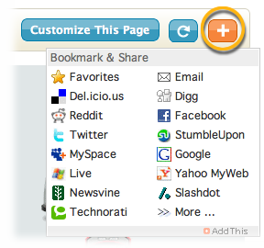
Lab 6
Webinar 5 Review
Live Directories
Free Live Directories
Paid Live Directories
Social Bookmarking
Social Bookmarking
Q&A
Notes:
1. Existing Knowledge
2. Facebook
3. Twitter
4. Stumble-upon
5. Digg
6. Google+

Slide 34
Lab 7
Webinar 6 Review
The Popularity Contest
Creating Anchor Text
Blog Comments
Web 2.0 Properties
Blogs
Videos
Forums
Awesome Site
Photos
Directories
Social Bookmarks
Web 2.0
Q&A
Notes:
Link trading = bad Creating links = Good
Make sure you’ve optimized your site first
The internet like high school, a popularity contest. Say you think you’re the best runner in the whole school. You can go around tooting your horn about how great you are at running, but how many people are going to believe you? Probably not very many since you’re the only one that seems to think you’re a great runner. However, if the Track Coach and the Student Body President and the Captain of the football team all start talking about how fast you are, how amazing you are at running…people are going to agree that you’re a good runner.
The same thing applies with search engines, Google in particular. Say you’re selling shoes and you’ve optimized your site saying you’re all about shoes Google will cache your site and maybe give you a page rank of NA, but they probably won’t do much else. However, if other sites that talk about shoes start linking back to your site, Google will take notice. The idea is to gain quality links on a number of types of sites that link back to your site.

Slide 35
Lab 7
Webinar 6 Review
The Popularity Contest
Creating Anchor Text
Blog Comments
Web 2.0 Properties
Anchor Text is the visible, clickable text in a hyperlink. The words contained in the anchor text can determine the ranking that the page will receive by search engines.
When creating external links you will use your keyword phrases as your Anchor Text. This tells Google that the site we are linking to is about that keyword.
“…clickable text in a <a href=“http://website.com”>hyperlink</a>. The words…”
Q&A
Notes:
Example sites with Anchor Text:
http://www.washingtonpost.com/sports/wizards/wizards-losing-tradition-makes-dc-sports-fans-hesitant-to-embrace-washingtons-nba-team/2011/10/26/gIQAd95YaM_story.html
Literally tells google why you’re linking.

Slide 36
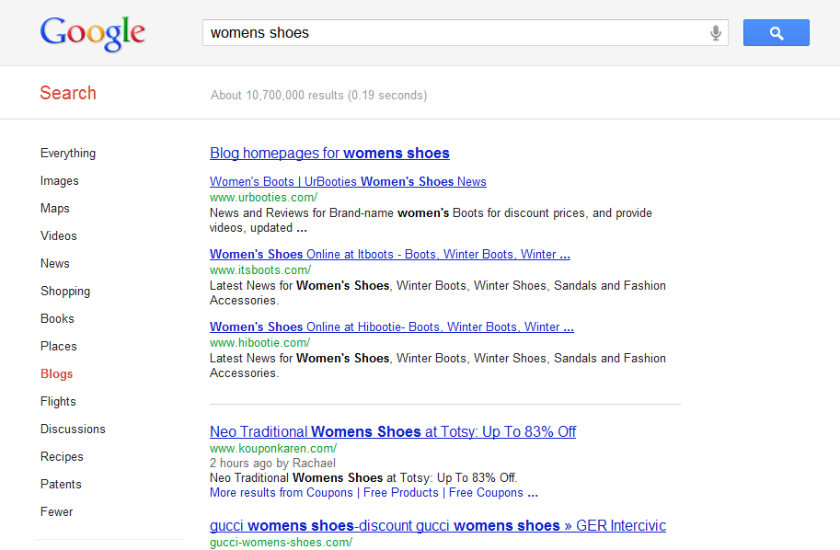
Lab 7
Webinar 6 Review
The Popularity Contest
Creating Anchor Text
Blog Comments
Web 2.0 Properties
Q&A
Notes:
Blogs/Discussions/Photos/Videos/Top 100 positions/Recipes/Shopping etc

Slide 37
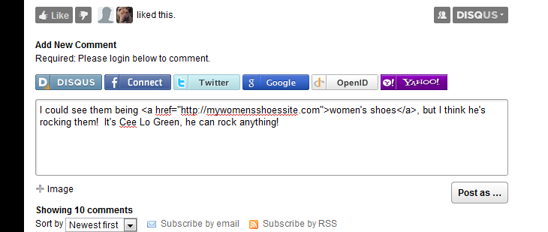
Lab 7
Webinar 6 Review
The Popularity Contest
Creating Anchor Text
Blog Comments
Web 2.0 Properties
Q&A
Notes:
Differences between blog comments and blogs promoting the site.
Make it natural, these are not promoting your site directly. They need to be relevant to the article, but not look like spam.

Slide 38
Lab 7
Webinar 6 Review
The Popularity Contest
Creating Anchor Text
Blog Comments
Web 2.0 Properties
A Web 2.0 is a web applications that facilitates information sharing, user-centered design, and collaboration on the Web.
A Web 2.0 site allows users to interact and collaborate with each other in a social media dialogue as creators of user-generated content in a virtual community.
Examples of Web 2.0 include social networking sites, blogs, wikis, video sharing sites, sites like Squidoo and other web applications.
Q&A
Notes:
Promotes site, interactive. Not made BY your site,

Slide 39
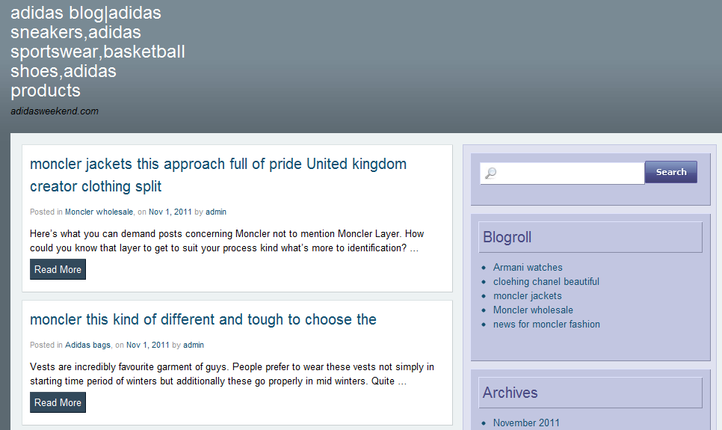
Lab 7
Webinar 6 Review
The Popularity Contest
Creating Anchor Text
Blog Comments
Web 2.0 Properties
Creating Blogs
∙ Blogger
∙ Wordpress
∙ Thoughts.com
Q&A
Notes:
http://www.adidasweekend.com/

Slide 40
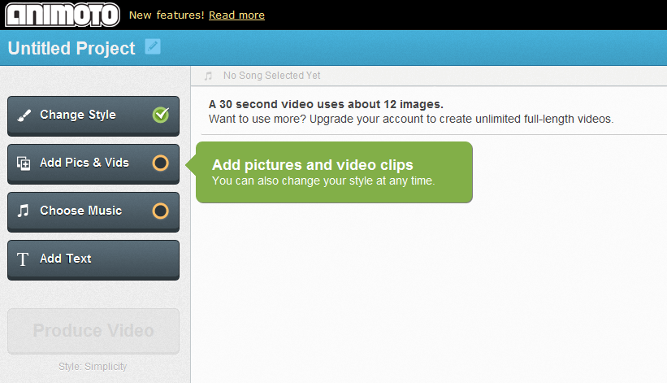
Lab 7
Webinar 6 Review
The Popularity Contest
Creating Anchor Text
Blog Comments
Web 2.0 Properties
Creating Videos
∙ Flixtime
∙ Animoto
Q&A

Slide 41
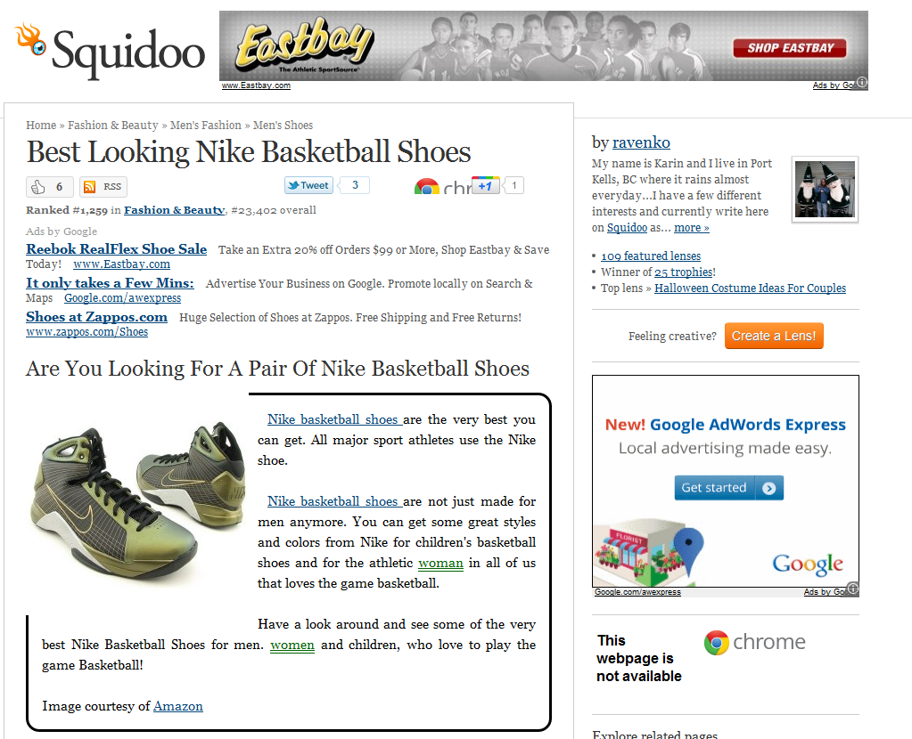
Lab 7
Webinar 6 Review
The Popularity Contest
Creating Anchor Text
Blog Comments
Web 2.0 Properties
Other Web 2.0
∙ Squidoo
∙ WikiHow
∙ Landing Pages
Q&A
Notes:
http://www.squidoo.com/best-looking-nike-basketball-shoes
http://www.wikihow.com/Pick-out-Basketball-Shoes

Slide 42

Lab 7
Webinar 6 Review
The Popularity Contest
Creating Anchor Text
Blog Comments
Web 2.0 Properties
Questions
Answers
Q&A

